Slide 1
National Accounts Statistics of Nepal 2014/15 (Annual Estimate)
Press Release Program
08 June, 2015
Central Bureau of Statistics

Slide 2
Growth Scenario
Broader Groups | Before Earthquake | After Earthquake
Agriculture, Forestry and Fishing | 2.25 | 1.87
Non-Agriculture | 5.66 | 3.57
Gross Domestic Product (GDP) at basic prices | 4.58 | 3.04

Slide 3
Growth Scenario
Industrial Classification | Before Earthquake | After Earthquake
Agriculture and forestry | 2.17 | 1.79
Fishing | 6.32 | 6.31
Mining and quarrying | 4.28 | 0.86
Manufacturing | 4.55 | 2.35
Electricity gas and water | 1.17 | 1.16
Construction | 5.89 | 3.56
Wholesale and retail trade | 5.59 | 3.43
Hotels and restaurants | 6.60 | 3.98
Transport, storage and communications | 7.88 | 5.23
Financial intermediation | 2.01 | 1.37
Real estate, renting and business activities | 4.86 | 0.77
Public administration and defence | 5.76 | 5.76
Education | 6.47 | 4.97
Health and social work | 9.82 | 10.04
Other community, social and personal service activities | 6.07 | 5.33

Slide 4
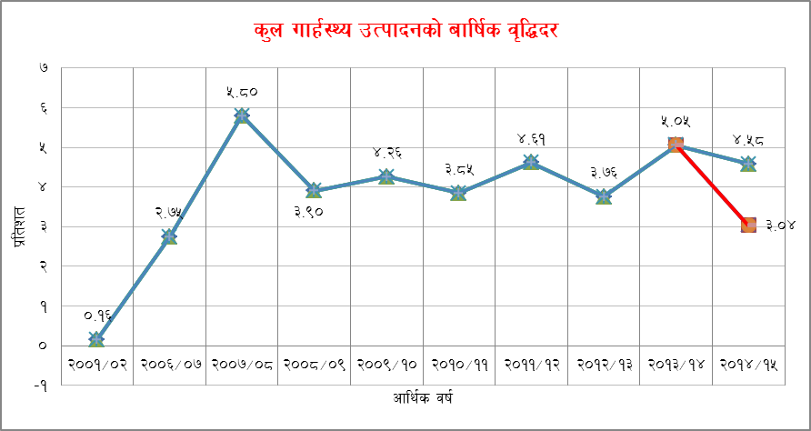

Slide 6
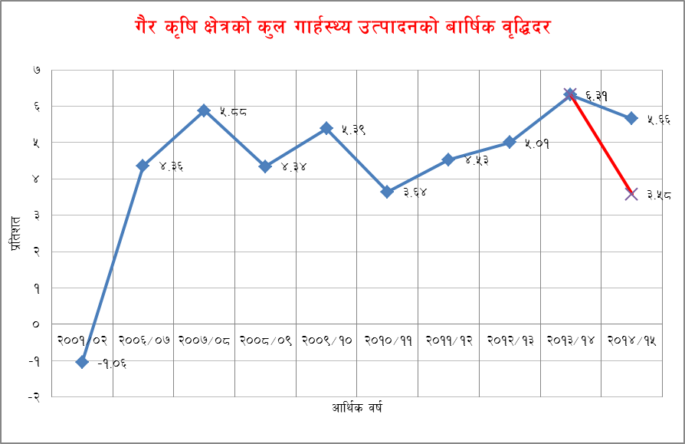

Slide 7
Growth Scenario
Broader Groups | Before Earthquake | After Earthquake
Primary Sector | 2.27 | 1.85
Secondary Sector | 4.58 | 2.59
Tertiary Sector | 5.98 | 3.86

Slide 8
Size of Economy
 |  |  |  | Rs. millions
Description | 2013/14 | 2014/15 Before Earthquake | 2014/15 After Earthquake | Losses
Output | 2,857,120 | 3,146,376 | 3,094,283 | 52,093
Intermediate Consumption | 1,057,664 | 1,156,294 | 1,135,595 | 20,699
GDP | 1,941,624 | 2,161,175 | 2,124,650 | 36,526

Slide 9
Per capita GDP at nominal prices
 |  |  |  | .
Description | 2013/14 | 2014/15 Before Earthquake | 2014/15 After Earthquake | Losses
Percapita GDP (NRs.) | 70,394 | 77,311 | 74,985 | 2,326
Annual Change in nominal percapita GDP (%) | 13.02 | 9.82 | 6.52 | 3.3
Nominal Percapita GDP (US$) | 717 | 785 | 762 | 24

Slide 10
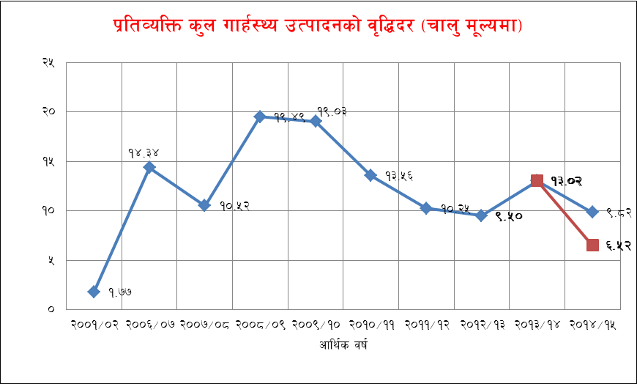

Slide 11
Composition of the economy

Slide 12
Thank you

