Slide 1

National Accounts Statistics of Nepal
(2020/21 Annual Estimates)
Press Release Program
April 30, 2021
Central Bureau of Statistics

Slide 2
Presentation Outline
Introduction
Growth Scenario of GDP
Value Added and Intermediate Consumption
Industry Wise Contribution to GDP
Key Macro Economic Indicators

Slide 3
Introduction
GDP compilation in Nepal was started in 1961/62
Regular compilation started since 1964/65
Compilation is based on SNA recommendation and current series are based on SNA 2008
Base year is 2010/11
Three years revision Policy (Preliminary, Revised, Final) is applied

Slide 4
Assumption
COVID pandemic will not affect more on the economy of Nepal
All economic activities will operate in noral condition after two weeks
Accommodation and food service activity may take more time to operate in normal condition.

Slide 5
GDP Growth Rate at Purchaser’s Price

Slide 6
Growth Scenario by Broad Industries
Broad Industry Group | 2018/19 | 2019/20 | 2020/21
Agriculture, Forestry and Fishing | 5.16 | 2.23 | 2.64
Non-Agriculture | 6.90 | -3.91 | 4.57
Gross Domestic Product (GDP) at Basic Prices (million) | 3,342,481 | 3,454,140 | 3,733,274
Gross Domestic Product (GDP) Purchaser’s Price (million) | 3,858,930 | 3,914,701 | 4,266,321

Slide 7
Growth rate of Agriculture and Non-agriculture

Slide 8
Growth Scenario at Basic Price

Slide 9
Share of GDP at Current Price

Slide 10
Size of Economy (at current price)
Rs. millions

Slide 11
GVA Growth Rate by Industries

Slide 12
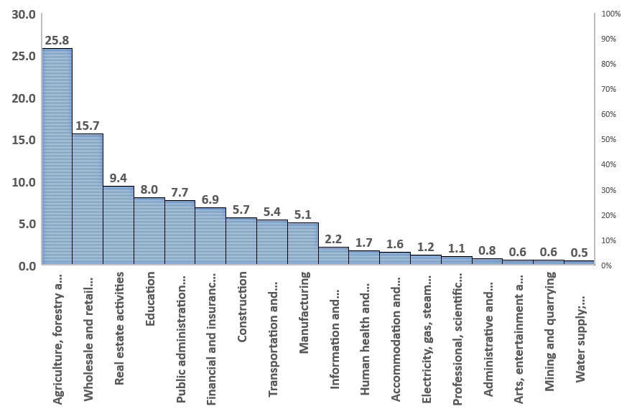
Share on GDP by Industries 2020/21

Slide 13
GVA Growth Scenario by Industries(Basic Price)
 | Industrial Classification | 2076/77 R | 2077/78 P
A | Agriculture, forestry and fishing | 2.23 | 2.64
B | Mining and quarrying | -2.23 | 7.49
C | Manufacturing | -8.57 | 3.85
D | Electricity, gas, steam and air conditioning supply | 25.58 | 7.74
E | Water supply; sewerage, waste management and remediation activities | 2.15 | 1.61
F | Construction | -4.99 | 5.56
G | Wholesale and retail trade; repair of motor vehicles and motorcycles | -10.69 | 5.27
H | Transportation and storage | -13.37 | 6.12
I | Accommodation and food service activities | -36.97 | 11.20
J | Information and communication | 2.30 | 1.45
K | Financial and insurance activities | 4.75 | 5.82
L | Real estate activities | 2.37 | 2.64
M | Professional, scientific and technical activities | 1.20 | 2.32
N | Administrative and support service activities | 2.15 | 2.17
O | Public administration and defence; compulsory social security | 5.98 | 3.49
P | Education | 3.20 | 3.60
Q | Human health and social work activities | 5.20 | 6.53
R, S, T, U | Arts, entertainment and recreation; Other service activities | 1.77 | 3.09

Slide 14
Per capita GDP, GNI and GNDI in (US$)

Slide 15
Key Macro economic Indicators
Industries | 2075/76 | 2076/77R | 2077/78P
Nominal Per capita GDP (US $) | 1159 | 1126 | 1191
Nominal Per capita GNI (US $) | 1171 | 1139 | 1196
Nominal Per capita GNDI (US$) | 1470 | 1422 | 1486
Final consumption expenditure as % of GDP | 84.70 | 93.65 | 93.38
Gross domestic saving as % of GDP | 15.30 | 6.35 | 6.62
Gross national saving as % of GDP | 42.12 | 32.61 | 31.40
Gross fixed capital formation as % of GDP | 33.82 | 28.43 | 27.26

Slide 16
Key Macro economic Indicators (Cont.)
Industries | 2075/76 | 2076/77R | 2077/78P
Exports of goods and services as percentage of GDP | 7.78 | 6.76 | 5.08
Imports of goods and services as percentage of GDP | 41.47 | 33.89 | 32.83
Workers' Remittances as percentage of GDP | 22.79 | 22.35 | 22.28
Resource Gap as percentage of GDP( +/-) | 0.74 | 4.21 | 0.63

Slide 17
Thank You

