Slide 1
National Accounts Statistics of Nepal (2021/22 Annual Estimates)
Press Release Program
April 28, 2022
(२०७९, बैशाख १५)
Central Bureau of Statistics

Slide 2
Presentation Outline
Introduction
Growth Scenario of GDP
Value Added and Intermediate Consumption
Industry Wise Contribution to GDP
Key Macro Economic Indicators

Slide 3
Introduction
GDP compilation in Nepal was started in 1961/62
Regular compilation started since 1964/65
Compilation is based on SNA recommendation and current series are based on SNA 2008
Base year is 2010/11
Three years revision Policy (Preliminary, Revised, Final) is applied

Slide 4
Assumptions
If everything remains the same, the economic performance of all economic sectors will be the same as in a normal year.
COVID pandemic will not affect more than the existing condition in coming three months
No any shock is expected

Slide 5
GDP Growth Rate at Purchaser’s Price

Slide 6
Growth Scenario by Broad Industries
Broad Industry Group | 2019/20 | 2020/21 | 2021/22
Agriculture, Forestry and Fishing (Growth in Percentage) | 2.4 | 2.9 | 2.3
Non-Agriculture (Growth in Percentage) | -4.4 | 4.3 | 6.9
Gross Domestic Product (GDP) at Basic Prices (million) | 3,428,524 | 3,662,498 | 4,105,541
Gross Domestic Product (GDP) Purchaser’s Price (million) | 3,888,704 | 4,277,302 | 4,851,625

Slide 7
Growth rate of agriculture, Non-agriculture, and GDP growth

Slide 8
Growth Scenario at Basic Price

Slide 9
Share of GDP at Current Price

Slide 10
Size of Economy (at current price)
Rs. billions

Slide 11
Share on GDP by Industries 2021/22

Slide 12
GVA Growth Scenario by Industries (Basic Price)
 | Industrial Classification | 2076/77 | 2077/78 R | 2078/79P
A | Agriculture, forestry and fishing | 2.4 | 2.9 | 2.3
B | Mining and quarrying | -2.2 | 7.5 | 8.2
C | Manufacturing | -9.0 | 4.1 | 6.1
D | Electricity, gas, steam and air conditioning supply | 19.5 | 2.6 | 36.7
E | Water supply; sewerage, waste management and remediation activities | 2.2 | 1.5 | 0.7
F | Construction | -4.4 | 5.2 | 9.5
G | Wholesale and retail trade; repair of motor vehicles and motorcycles | -11.4 | 5.7 | 9.1
H | Transportation and storage | -11.8 | 4.4 | 4.5
I | Accommodation and food service activities | -36.8 | 10.7 | 11.4
J | Information and communication | 2.0 | 1.8 | 3.6
K | Financial and insurance activities | -0.4 | 4.1 | 6.1
L | Real estate activities | 2.1 | 2.3 | 3.8
M | Professional, scientific and technical activities | 1.5 | 2.4 | 3.8
N | Administrative and support service activities | 2.2 | 2.3 | 4.4
O | Public administration and defence; compulsory social security | 6.2 | 3.4 | 4.1
P | Education | 3.2 | 3.9 | 4.1
Q | Human health and social work activities | 5.2 | 6.6 | 6.9
R, S, T, U | Arts, entertainment and recreation; Other service activities | 1.8 | 3.4 | 3.8
Over all |  | -2.4 | 4.3 | 5.8

Slide 13
GDP by Expenditure Approach (In Millions)

Slide 14
Composition of final consumption expenditure

Slide 15
Per capita GDP, GNI and GNDI in (US$)

Slide 16
Key Macro economic Indicators
Indicators | 2076/77 | 2077/78R | 2078/79P
Nominal Per capita GDP (US $) | 1156 | 1239 | 1372
Nominal Per capita GNI (US $) | 1170 | 1246 | 1381
Nominal Per capita GNDI (US$) | 1462 | 1557 | 1683
Final consumption expenditure as % of GDP | 94.3 | 92.3 | 90.7
Gross domestic saving as % of GDP | 5.7 | 7.7 | 9.3
Gross national saving as % of GDP | 32.2 | 33.3 | 31.9
Gross fixed capital formation as % of GDP | 30.5 | 29.9 | 29.4

Slide 17
Key Macro economic Indicators (Cont.)
Indicators | 2076/77 | 2077/78R | 2078/79P
Exports of goods and services as percentage of GDP | 6.8 | 5.2 | 6.6
Imports of goods and services as percentage of GDP | 34.1 | 38.6 | 41.5
Workers' Remittances as percentage of GDP | 22.5 | 22.5 | 19.8
Resource Gap as percentage of GDP( +/-) | 1.7 | -2.5 | -5.3

Slide 18
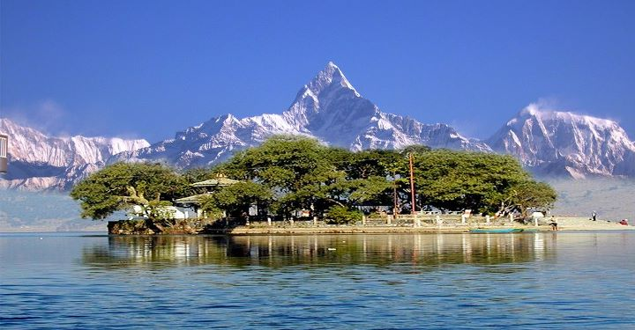
Thank You

