Slide 1
prevalence of psychotropic medication non-adherence and its contributing factors among patients with schizophrenia
Dr. Raja Singh, PGY1, Department of Psychiatry
Dr. Neena Rai, Associate professor, Department of Psychiatry
Dr. Pushpa Prasad Sharma, HOD , Department of Psychiatry

Slide 2
Objectives
General
To find out the prevalence of psychotropic medication non-adherence and to identify contributing factors among patients with schizophrenia attending our tertiary care hospital.
Specific
To assess psychotropic medication non-adherence in patients with schizophrenia using the MMAS-8 scale.
To identify socio-demographic, clinical and patient related factors of the study population in association with psychotropic medication non-adherence.
To evaluate level of insight using the clinical rating and its association with medication non-adherence.

Slide 3
Research questions / Hypothesis
What is the prevalence of psychotropic medication non-adherence and its contributing factors among patients with schizophrenia at tertiary care center?

Slide 4
Conceptual framework
(MMAS-8)
Forgetfulness
Change in routine/travel
Intentional discontinuation
Inconvenience
Patient related
Insight
Stigma
Recent substance use
Medication Non-Adherence
Socio-Demographic
Age
Gender
Marital status
Educational level
Occupation status
Address
Religion
Economic status
Clinical Factors
Family history psychiatric illness in 1st Degree relative
Total duration of illness
No. of psychotropic medication
Side-effects
No. of hospitalization

Slide 5
Methodology
1. STUDY METHOD/TYPE:
Quantitative, descriptive and analytical study.
2. STUDY DESIGN:
Hospital based cross sectional study.
3. STUDY PLACE / SITE AND JUSTIFICATION:
The study will be conducted at KIST Medical College Teaching Hospital, located in Imadol, Lalitpur, Nepal. As a tertiary care facility, the KISTMCTH receives a high volume of patients from the Kathmandu Valley and surrounding regions, providing adequate sample for the study.

Slide 6
4. STUDY POPULATION:
Patients of age 18 years old and above visiting to Psychiatry OPD, admitted in psychiatry ward and emergency at KIST Medical College & Teaching Hospital and diagnosed as schizophrenia, using ICD-11 DCR with the help of consultant psychiatrist.
5. STUDY UNIT:
The unit of study will be the individual patient.

Slide 7
6. STUDY PERIOD/ DURATION:
The study will be conducted over a period of one and half years (18 months).
7. STUDY VARIABLES:
A. Independent variables: Age, Gender, religion, Marital status, Educational status, Occupational status, Address, Economic status, Family history of psychiatric illness, total duration of illness, number of psychotropic medication, side-effects, number of hospitalization, insight, stigma, recent substance use(last 1 month).

Slide 8
B. Dependent variable: Medication adherence status which will be measured by Morisky Medication Adherence Scale (MMAS-8),with subtypes like forgetfulness, change in routine/travel, intentional discontinuation, inconvenience.

Slide 9
8. SAMPLE SIZE DETERMINATION:
Sample size of the study is calculated by using Cochran’s formula: n=z²pq/d²
Where, n=required sample size , d = margin of error (5%)
p= 89.4% = 0.894 (Subedi S, Paudel K, Thapa DK. Treatment non-compliance in patients with schizophrenia. J Univ Coll Med Sci. 2020;8(1):3–8. doi:10.3126/jucms.v8i1.29773)
q= 1-p = 1-0.894=0.106
z= 1.96 at 95% level of confidence.
p = 0.894, q = 0.106, d = 0.05
So, sample size (n) = z²pq/d²
n = (1.96)* (0.894)* (1-0.894) / (0.05)²
n = 144.4 = 145 (approx.)
To account for potential non-response, incomplete data or dropouts, 10% increase was applied, giving a final sample size of 160 patients.

Slide 10
9. SAMPLING METHOD/TECHNIQUES:
A convenience sampling method will be used, where eligible patients will be approached sequentially for the participation.
10. SELECTION CRITERIA:
Inclusion Criteria
Age 18-65 years.
A confirmed clinical diagnosis of Schizophrenia and on psychotropic medication for at least one month.

Slide 11
B. Exclusion Criteria:
Patients experiencing acute psychosis episode, severe agitation, severe cognitive impairment.
Co-morbid severe medical or neurological illness.

Slide 12
11. DATA COLLECTION TOOLS AND TECHNIQUES(METHOD):
Prospective, Real-Time Collection: Data will be collected prospectively as patients arrive at the Emergency, psychiatry ward and OPD Department, ensuring accurate and timely information. Each eligible patient will be identified and enrolled consecutively until the calculated sample size is reached. Structured Proforma: A pre-designed, structured data collection form will be used to capture all relevant information.
Verification from Hospital Records: Data collected from the proforma will be cross-checked to ensure completeness and accuracy.
Confidentiality and Coding: Each patient will be assigned a unique study ID.
No personal identifiers will be used during analysis to maintain confidentiality.

Slide 13
DATA COLLECTION TOOLS
Semi-Structured Questionnaire: A specially designed socio-demographic and clinical datasheet by department of psychiatry of KIST Medical College & Teaching Hospital, which includes Age, Gender, religion, Marital status, Educational status, Occupational status, Address, Economic status, Family history of psychiatric illness, diagnosis, total duration of illness, number of psychotropic medication, side-effects, number of hospitalization, recent substance use(last 1 month), stigma, insight(clinical related) has been included in the questionnaire.

Slide 14
International Classification of Disease – Diagnostic criteria for research (ICD-11) DCR : It is an operational diagnostic system that classify known psychological disorders based on the experienced symptoms according to the number of criteria. Diagnosis of Schizophrenia will be confirmed using ICD-11 DCR.
Morisky Medication Adherence Scale (MMAS-8) will be used to access the medication non-adherence a widely used self-report tool developed by Donald Morisky. It has 8 items (7 yes/no, 1 on a Likert scale), total score (0-8) which will be categorized as: High non-adherence (≥2), Medium non-adherence (1-2) and Low non-adherence (0). This is a patient reported scale administered through a face-to-face interview by the investigator, average time required is 5 to 7 minutes. Permission for the use of MMAS-8 was sought from the original author, Dr. Morisky. The English and nepali versions, validated and used in previous studies, were obtained with permission and will be used in this study. (Subedi S, Paudel K, Thapa DK. Treatment non-compliance in patients with schizophrenia. J Univ Coll Med Sci. 2020;8(1):3–8. doi:10.3126/jucms.v8i1.29773)

Slide 15
Insight will be assessed using clinical rating of Insight on 5 point scale, which is a structured clinician-rated scale widely used to evaluate insight in schizophrenia. (Kaplan & sadocks, CTP)
The assessment will be conducted by the investigator during the patient interview and recorded in the semi-structured Proforma.

Slide 16
12. VALIDITY AND REALIBILITY OF THE TOOLS:
The MMAS-8 has been widely validated in multiple chronic illnesses, including psychiatric disorders. In the original validation study, the MMAS-8 scale showed a good internal consistency with a Cronbach’s alpha of 0.83, as well as significant associations with blood pressure control, supporting its predictive validity. [26]
In a Nepalese study among patients with schizophrenia, the MMAS-8 showed a satisfactory reliability with a Cronbach’s alpha of 0.75, confirming its application in psychiatric populations visiting tertiary hospitals of Nepal. [27]
The scale has also shown concurrent validity when compared with pill counts, pharmacy refill records, and clinical outcomes across multiple chronic conditions. [26,28]

Slide 17
13. PRETESTING THE DATA COLLECTION TOOL:
Not applicable

Slide 18
14. PLAN FOR DATA MANAGEMENT AND ANALYSIS:
Data will be collected via prepared questionnaire filled up in Psychiatry Inpatient, Outpatient and Emergency Consultation at KIST Medical College and Teaching Hospital.
This data will be stored as hard copies and will be filed.
This data will be stored as a soft copy on the computer.
The references will be managed with Mendeley software.
SPSS version 17 will be used during data entry and analysis.
Data will be presented as percentages and mean (standard deviation).
Thus obtained continuous variables will be presented as mean ± SD; categorical as frequency and percentages.
Chi-square test will be used to identify the association between categorical variables and independent t-test or ANOVA test will be used for continuous variable. P value <0.05 will be considered as statistically significant.
The data stored in secured containers would be accessible only to the investigator and handled with utmost discretion.
The results of the study may be shared in scientific articles and publications, seminars, and discussions, however the confidentiality of the participants and their response will be maintained.
Notes:
Mean : arithmetic avg of a set of values, found by adding all the no together and// toal no of value SD measures how much value differ from mean
Meadian:middle value in a sorted list of numbers, if even then it is avg of two middle values, mode: value that appear most often

Slide 19
15. POTENTIAL BIASES:
First, recall bias may occur because adherence are measured by self-report questionnaires and patients may underreport or over-report activity due to social desirability or lack of insight. Second, selection bias may occur even with convenience sampling because only those patients who happen to present at the hospital during the study period and are clinically stable enough to give consent will be included, thus possibly missing those with extreme non-adherence or treatment dropout.

Slide 20
16. LIMITATIONS OF THE STUDY:
Only schizophrenia is included in the study.
Data collection is done at Kist Medical College and Teaching Hospital in 12 months of duration thus these results will be difficult to generalize entire population of the country.

Slide 21
Ethical consideration
The research will be conducted along with ethical soundness. The following points will be strictly followed:
Approval for research conduction will be obtained from Institutional Review Committee of KIST Medical College and Teaching Hospital.
The patient and the primary caretaker will be informed in detail about the study.
All the patients will receive standard care whether he/she participate in the study or not.
All the clinical judgment regarding patient care, investigations and further management will be decided by the consultant(s).
The patient and the primary caretaker will have full right to refuse their participation in the study and the freedom to withdraw from survey without any objection.
Personal identity and background information of the participants will be kept confidential and thus obtained information will solely be used for research purpose only.

Slide 22
Expected outcome
The study will generate the first validated, quantitative estimation of prevalence of psychotropic medication non-adherence and its contributing factors among patients with schizophrenia at Tertiary care Hospital.
This study in mental health care will pave the pathway for better policy making and thus help in early intervention.

Slide 23
Plan for dissemination and utilization of findings
Findings will be disseminated through peer-reviewed publications in high-impact journals. Thus generated results will be presented at national and international conferences.

Slide 24
Gantt chart
 |  | Duration/date | Duration/date | Duration/date | Duration/date | Duration/date | Duration/date | Duration/date
Work |  | 2082/05/01 To 2082/06/09 | 2082/06/10 To 2082/08/21 | 2082/08/21 To 2082/10/30 | 2082/11/01 To 2083/01/01 | 2083/01/02 To 2083/01/30 | 2083/02/01 To 2083/06/30 | 2082/07/01 To 2083/10/30
Proposal writing
Anticipated Time of approval
Literature review
IRC Submission
Proposal approval
Data collection
Data entry
Data analysis
Thesis preparation
Thesis submission

Slide 25
References
1. Chakrabarti S. Medication non-adherence in bipolar disorder: Review of rates, demographic and clinical predictors. World J Meta-Anal. 2017;5(4):103-123. doi:10.13105/wjma.v5.i4.103
2. Deng M, Zhai S, Ouyang X, Liu Z, Ross B. Factors influencing medication adherence among patients with severe mental disorders from the perspective of mental health professionals. BMC Psychiatry. 2022 Jan 7;22(1):22. doi: 10.1186/s12888-021-03681-6. PMID: 34996394; PMCID: PMC8740063.
3. Kane JM, Kishimoto T, Correll CU. Non-adherence to medication in patients with psychotic disorders: epidemiology, contributing factors and management strategies. World Psychiatry. 2013 Oct;12(3):216-26. doi: 10.1002/wps.20060. PMID: 24096780; PMCID: PMC3799245.
4. Sabaté E, editor. Adherence to long-term therapies: evidence for action. World health organization; 2003.

Slide 26
5. Jimmy B, Jose J. Patient Medication Adherence: Measures in Daily Practice. Oman Med J. 2011 Mar;26(3):155-159.
6. Khan J, Khan JA, Kumari S, Charan D. Treatment Non-adherence Patterns Among Patients With Mental Illness: A Study From the District Mental Health Care Center in India. Cureus. 2024 Feb 19;16(2):e54495. doi: 10.7759/cureus.54495. PMID: 38516451; PMCID: PMC10955436.
7. Cutler RL, Fernandez-Llimos F, Frommer M, Benrimoj C, Garcia-Cardenas V. Economic impact of medication non-adherence by disease groups: a systematic review. BMJ Open. 2018 Jan 21;8(1):e016982. doi: 10.1136/bmjopen-2017-016982. PMID: 29358417; PMCID: PMC5780689.
8. Ghosh P, Balasundaram S, Sankaran A, Chandrasekaran V, Sarkar S, Choudhury S. Factors associated with medication non-adherence among patients with severe mental disorder - A cross sectional study in a tertiary care centre. Explor Res Clin Soc Pharm. 2022 Sep 12;7:100178. doi: 10.1016/j.rcsop.2022.100178. PMID: 36161207; PMCID: PMC9493377.

Slide 27
9. Semahegn A, Torpey K, Manu A, Assefa N, Tesfaye G, Ankomah A. Psychotropic medication non-adherence and its associated factors among patients with major psychiatric disorders: a systematic review and meta-analysis. Syst Rev. 2020 Jan 16;9(1):17. doi: 10.1186/s13643-020-1274-3. PMID: 31948489; PMCID: PMC6966860.
10. Weiden PJ, Kozma C, Grogg A, Locklear J. Partial compliance and risk of rehospitalization among California Medicaid patients with schizophrenia. Psychiatr Serv. 2004 Aug;55(8):886-91. doi: 10.1176/appi.ps.55.8.886. PMID: 15292538.
11. Farooq S, Naeem F. Tackling nonadherence in psychiatric disorders: current opinion. Neuropsychiatr Dis Treat. 2014 Jun 12;10:1069-77. doi: 10.2147/NDT.S40777. PMID: 24966677; PMCID: PMC4062556.
12. Rathod S, Pinninti N, Irfan M, Gorczynski P, Rathod P, Gega L, Naeem F. Mental Health Service Provision in Low- and Middle-Income Countries. Health Serv Insights. 2017 Mar 28;10:1178632917694350. doi: 10.1177/1178632917694350. PMID: 28469456; PMCID: PMC5398308.

Slide 28
13. Alloh FT, Regmi P, Onche I, van Teijlingen E, Trenoweth S. Mental Health in low-and middle income countries (LMICs): Going beyond the need for funding. Health Prospect. 2018 Jun 19;17(1):12-17. doi:10.3126/hprospect.v17i1.20351.
14. World Health Organization. Mental Health ATLAS 2020. Geneva: WHO; 2021. ISBN: 978-92-4-003670-3.
15. García S, Martínez-Cengotitabengoa M, López-Zurbano S, Zorrilla I, López P, Vieta E, González-Pinto A. Adherence to Antipsychotic Medication in Bipolar Disorder and Schizophrenic Patients: A Systematic Review. J Clin Psychopharmacol. 2016 Aug;36(4):355-71. doi:10.1097/JCP.0000000000000523. PMID: 27307187; PMCID: PMC4932152.
16. Ramamurthy P, Jayasree A, Solomon S, Rudravaram VV, Menon V, Thilakan P. Medication nonadherence and its associated factors in psychiatric patients in India: a systematic review and meta-analysis. Indian J Psychiatry. 2023 May;65(5):506-525. doi:10.4103/indianjpsychiatry.indianjpsychiatry_249_22

Slide 29
17. Dur-e-Nayab A, Aleem S. Factors associated with medication non-compliance in patients with schizophrenia: a cross-sectional study in Peshawar [preprint]. Research Square. 2025 Aug 17. Available from: https://doi.org/10.21203/rs.3.rs-7362033/v1
18. Gudeta DB, Leta K, Alemu B, Kandula UR. Medication adherence and associated factors among psychiatry patients at Asella Referral and Teaching Hospital in Oromia, Ethiopia: institution based cross sectional study. PLoS One. 2023 Apr 13;18(4):e0283829. doi:10.1371/journal.pone.0283829
19. Novick D, Montgomery W, Treuer T, Aguado J, Kraemer S, Haro JM. Relationship of insight with medication adherence and the impact on outcomes in patients with schizophrenia and bipolar disorder: results from a 1-year European outpatient observational study. BMC Psychiatry. 2015 Aug 5;15:189. doi: 10.1186/s12888-015-0560-4. PMID: 26239486; PMCID: PMC4524170.
20. Ibrahim AW, Pindar SK, Yerima MM, Rabbebe IB, Shehu S, Garkuwa HA, et al. Medication-related factors of non-adherence among patients with schizophrenia and bipolar disorder: outcome of a cross-sectional survey in Maiduguri, North-eastern Nigeria. J Neurosci Behav Health. 2015;7(5):31-39. doi:10.5897/JNBH2015.0128

Slide 30
21. Delcine JM, Shivanand HB, Sameer MB, Arunkumar C, Anusha MS, Desai M. Prevalence and factors associated with medication nonadherence in patients with major psychiatric disorders in Southern India. Taiwan J Psychiatry. 2023;37(4):182-187. doi:10.4103/TPSY.TPSY_32_23
22. Lucca JM, Ramesh M, Parthasarathi G, Ram D. Incidence and factors associated with medication nonadherence in patients with mental illness: a cross-sectional study. J Postgrad Med. 2015 Oct-Dec;61(4):251-6. doi: 10.4103/0022-3859.166514. PMID: 26440396; PMCID: PMC4943371.
23. Paudel K, Subedi S. Treatment Non-Compliance in Patients suffering from Schizophrenia and Bipolar affective Disorder (BPAD): a comparative study. Journal of Psychiatrists Association of Nepal [Internet]. 2019 Dec 31;8(2):20–5. Available from: https://doi.org/10.3126/jpan.v8i2.28020
24. Lama S, Lakshmi KV, Shyangwa PM, Parajuli P. Level of compliance and factors associated with non-compliance to treatment among the mentally ill patients. Health Renaissance. 2012 Jul;10(2):113-7. doi:10.3126/hren.v10i2.6577

Slide 31
25. Kaplan HI, Sadock BJ, Sadock VA. Comprehensive Textbook of Psychiatry. 11th ed. Philadelphia: Wolters Kluwer; 2023.
26. Morisky DE, Ang A, Krousel-Wood M, Ward HJ. Predictive validity of a medication adherence measure in an outpatient setting. J Clin Hypertens (Greenwich). 2008;10(5):348–54.
27Subedi S, Paudel K, Thapa DK. Treatment non-compliance in patients with schizophrenia. J Univ Coll Med Sci. 2020;8(1):3–8. doi:10.3126/jucms.v8i1.29773
28. Krousel-Wood M, Islam T, Webber LS, Re RN, Morisky DE, Muntner P. New medication adherence scale versus pharmacy fill rates in seniors with hypertension. Am J Manag Care. 2009;15(1):59–66.

Slide 32
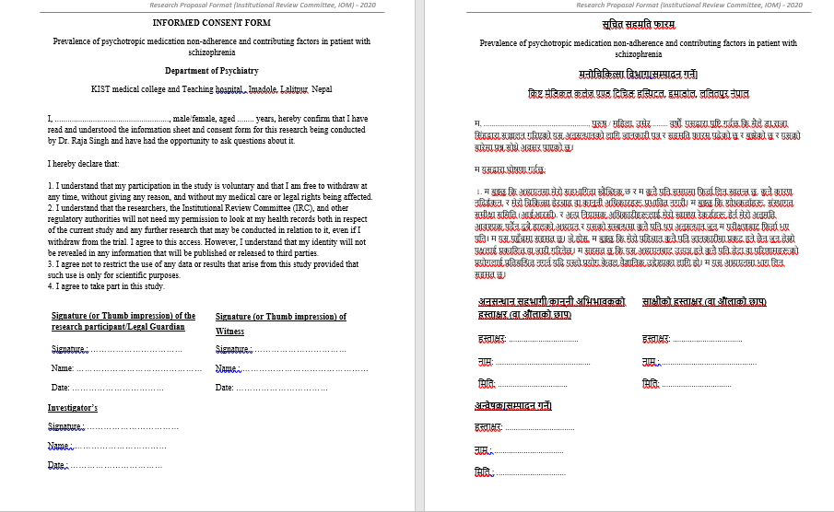
Consent form

Slide 33
Dummy Table
S.No. | CHARACTERISTICS | CATEGORIES | FREQUENCY | PERCENTAGE (%)
1. | Age in years | <40 ≥40
2. | Gender | Male Female
3. | Religion | Hindu Buddhist Christian Muslim Others
4. | Education status | Illiterate Primary level Secondary level Bachelor’s and above
5. | Marital status | Married Unmarried Separated or divorcee
6. | Occupation status | Employed (Regular Job) Unemployed Student Housewife/Homemakers
7. | Address | Inside valley Outside valley
8. | Economic status | Low Middle High
SOCIO-DEMOGRAPHIC

Slide 34
S.NO. | CHARACTERISTICS | CATEGORIES | FREQUENCY | PERCENTAGE
1. | Family history of Psychiatric illness | Yes No
2. | Duration of illness | Less than 1 year 1-2 years 3-5 years More than 5 years
3. 4. 5. | No. of psychotropic medication Side-effects No. of Hospitalization | Single Double More than 2 Yes No Never Once 2 or more
CLINICAL

Slide 35
S.NO. | CHARACTERISTICS | CATEGORIES | FREQUENCY | PERCENTAGE
6. | Insight | Complete denial of illness (2)Slight awareness of being sick and needing help but denying it at the same time (3) awareness of being sick but it is attributed to external or physical factors (4) Intellectual insight (5) Emotional insight
7. | Stigma | Yes No
8. | Recent substance use(last 1 month) | Yes No

Slide 36
Medication non-adherence (MMAS-8)
Non-adherence | Score range | Frequency | Percentage(%)
High non-adherence | >=2
Medium non-adherence | 1-2
Low non-adherence | 0
TOTAL

Slide 37
Questionnaire Or Proforma
Semi-structured Questionnaire
Name:
Gender:
Age:
Marital status: 1. Married 2. Unmarried 3. Separate or divorcee
Education: 1.Illliterate 2.Primary level 3.Secondary level 4.Bachelor’s and above

Slide 38
Questionnaire Or Proforma cont..
Religion: 1. Hindu 2. Buddhist 3. Christian 4.Muslim 5. Other
Occupation:1. Employed (Regular Job) 2. Unemployed 3. Student
4. Housewife/Homemakers
Address: 1. Inside valley 2. Outside valley
Economic status: 1. Low income (Struggle for daily needs) 2. Middle income (Stable but vulnerable) 3. High income (Financially secure)

Slide 39
Questionnaire Or Proforma cont..
Family history of Psychiatric illness : 1. Yes 2. No(if yes specify)
Total duration of illness:1. Less than 1 year 2. 1-2 years 3. 3-5 years 4.More than 5 years
No. of psychotropic medication: 1. Single 2. Double 3. More than 2
Side-effects: 1. yes 2. No

Slide 40
Questionnaire Or Proforma cont..
No. of hospitalization: 1. Never 2. Once 3. 2 or more
Insight(clinical): Grade 1/2/3/4/5
Stigma: 1. yes 2. No
Recent substance use (Last 1 month): 1.yes 2. No

Slide 41
Questionnaire Or Proforma cont..
Morisky 8-Item Medication Adherence Questionnaire
Patient Answer (Yes/No) Score Yes=1; No=0
You indicated that you are taking medication for your problem. Individuals have identified several issues regarding their medication-taking behavior and we are interested in your experiences. There is no right or wrong answer. Please answer each question based on your personal experiences with your health/medication. Interviewers may self-identify regarding difficulties they may experience concerning medication taking behavior.

Slide 42
Questionnaire Or Proforma cont..
S.No. | Components |  |  |  | Yes | No
1 | Do you sometimes forget to take your medicine?
2 | People sometimes miss taking their medicines for reasons other than forgetting. Thinking over the past 2 weeks, were there any days when you did not take your medicine?
3 | Have you ever cut back or stopped taking your medicine without telling your doctor because you felt worse when you took it?
4 | When you travel or leave home, do you sometimes forget to bring along your medicine?
5 | Did you take all your medicines yesterday?
6 | When you feel like your symptoms are under control, do you sometimes stop taking your medicine?
7 | Taking medicine every day is a real inconvenience for some people. Do you ever feel hassled about sticking to your treatment plan?
8 | How often do you have difficulty remembering to take all your medicine? | A | B | C | D | E
Total score

Slide 43
Questionnaire Or Proforma cont..
Note: A = 0; B-E = 1
Scores: >2 = High non-adherence, 1 or 2 = medium non- adherence and 0 = low non- adherence
Morisky DE et al., J Clin Hypertens (2008);10(5):348–354.

Slide 44
Questionnaire Or Proforma cont..
मोरस्की–८ बुँदे नियमित औषधि सेवन प्रश्नावली (MMAS-8)
उद्देश्य: यो प्रश्नावलीले बिरामीले आफ्नो औषधि कति नियमित रूपमा सेवन गर्छन् भन्ने कुरा मूल्यांकन गर्न प्रयोग गरिन्छ। प्रत्येक प्रश्न सावधानीपूर्वक बुझेर “हो” वा “होइन” भनी उत्तर दिनुहोस्। (अन्तिम बुँदामा A–E मध्ये उपयुक्त विकल्प चयन गर्नुहोस्।)

Slide 45
Questionnaire Or Proforma cont..
प्रश्नावली
क्र.सं. | प्रश्नहरू | हो | होइन
१ | के तपाईं कहिलेकाहीँ आफ्नो औषधि लिन बिर्सनु हुन्छ ?
२ | कहिलेकाहीँ मानिसहरू अन्य कारणले पनि औषधि छुटाउँछन् । पछिल्ला २ हप्ताभित्र तपाईंले कुनैदिन औषधि लिन बिर्सनु भएको थियो ?
३ | के तपाईंले औषधि खाँदा शरीरमा खराब असर (side effect) महसुस गरेर, डाक्टरको सल्लाह बिना नै औषधि बन्द गर्नुभएको थियो ?
४ | के तपाईंले यात्राको कारणले कहिलेकाहीँ औषधि छुटाउनुभएको छ ?
५ | के तपाईंले आफ्नो सबै औषधिहरू हिजो (अन्तिम दिन) खानुभएको थियो ?
६ | के तपाईंले आफ्नो रोगका लक्षणहरू नियन्त्रणमा छन् भन्ने महसुस गरेर कहिलेकाहीँ औषधि खान छुटाउनुभएको छ ?
७ | दैनिक रूपमा औषधि खानु कहिलेकाहीँ झन्झटिलो लाग्न सक्छ। के तपाईं आफ्नो उपचार निरन्तरता दिने विषयमा कहिल्यै हरेस खानु भएको छ ?

Slide 46
Questionnaire Or Proforma cont..
८. तपाईंलाई आफ्नो औषधि नियमित सेवन गर्न कत्तिको समस्या भएको छ ?
विकल्प | विवरण
A | कहिल्यै समस्या छैन
B | थोरै समस्या छ
C | मध्यम समस्या छ
D | धेरै समस्या छ
E | अत्यधिक समस्या छ

Slide 47
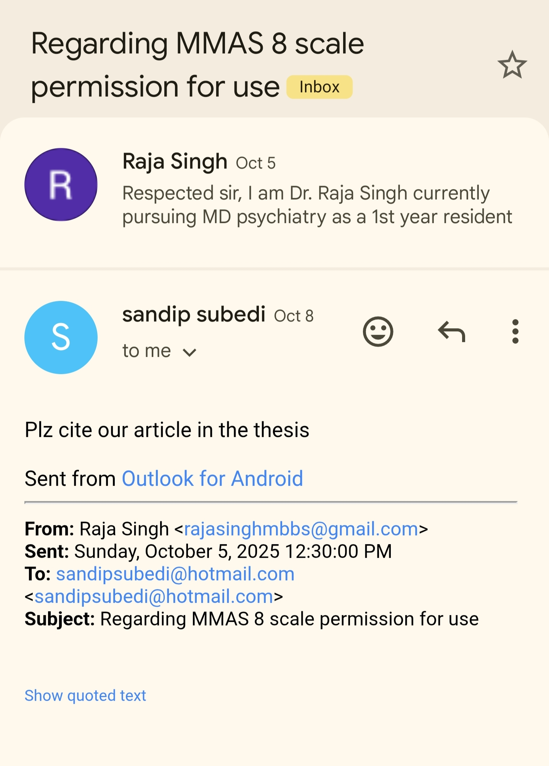

Slide 48
THANK YOU

